Slide 1

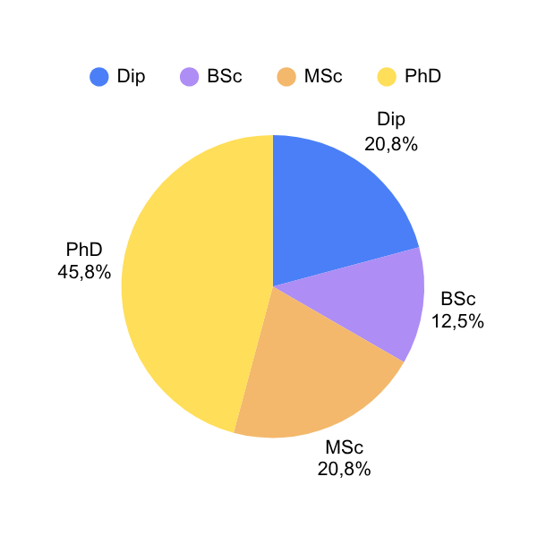
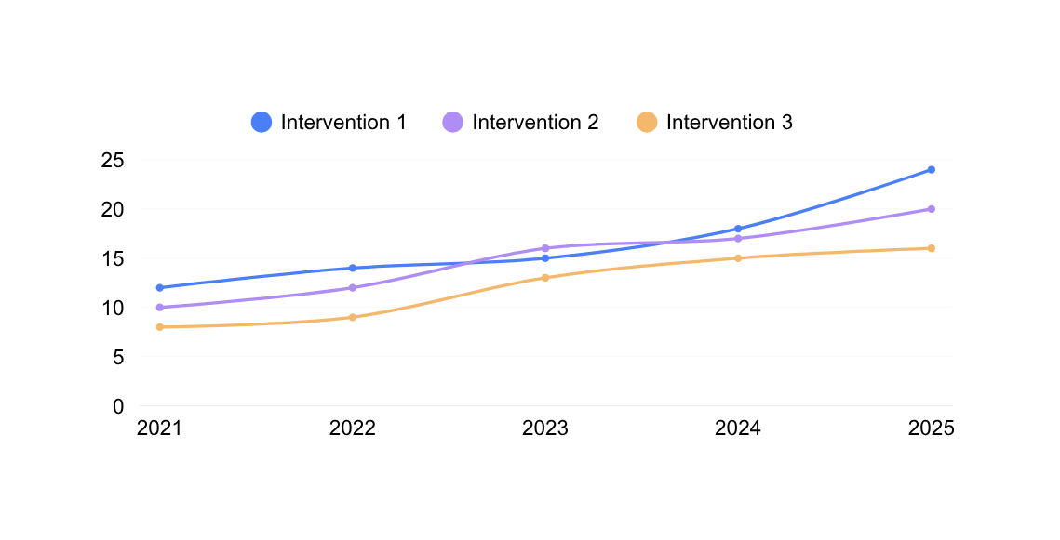
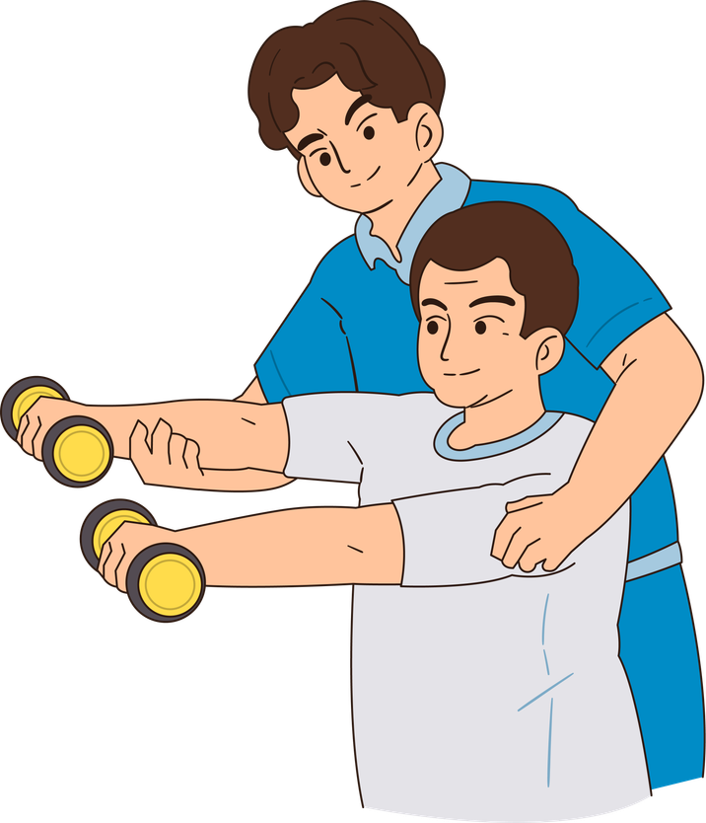
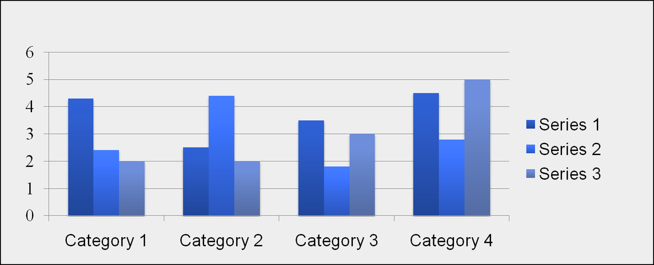
PRESENTED AT:
Insert your institution(s)’ logos at the top
TITLE
Authors’ Names Goes Here
(must match those on the submitted abstract)
Affiliations go here
Introduction
This is just an example of a layout, along with some tips and examples to help you create your poster.
You can adapt the content to best suit your abstract and even use a template provided by your institution.
The 6th Europe Region Physiotherapy Congress poster size is A0 (width: 84.1cm/33,1 inches x height: 118.9cm/46.8 inches) portrait. You should not use a collection of smaller sheets.
Check if your institution has a house style for posters, which may limit what colours and layout you can use.
Methods
If you are using this template:
Simply highlight this text and replace it by typing in your own text, or copy and paste your text.
You can change the colour of the text, title and poster background.
You can change the layout, design and sections, as well as their order, to suit your needs.
If there are points you want to emphasis use bold rather than italics.
Results
Images on the left should have the caption on the right and be set to left align text.
Remember to add captions to explain images, tables and graphs. Align the text next to the image i.e. right aligned if the image is on the right.
Caption
Purpose
The page size of this poster template is A0 width: 84.1cm/33,1 inches x height: 118.9cm/46.8 inches) portrait format. Do not change this page size, the printer can scale-to-fit a smaller size when printing.
Discussion and Conclusions
Make your conclusions succinct and clear
Note: Do not leave your poster until the last minute. Several drafts are usually required and ask colleagues for feedback. Its worth looking at a full scale version so you can check it is readable and attractive.
Coated and laminated posters are more durable. Poster tubes help to protect posters in transit.
There are a number of companies producing fabric posters that can be folded for travel.
Results
Think about how you can expand on what you included in your abstract.
When laying out your poster leave breathing space around your text. Don’t overcrowd your poster.
Images such as photographs, graphs, diagrams, logos, etc, can be added to the poster and will enhance its appearance and help to break up blocks of text.
The best type of image files to insert are JPEG or TIFF.
Participants
Use font faces that are easy to read, such as Arial or Verdana.
The section headings in this template are in 48pt. Most of the body text is 32pt. The recommended range is 24pt-36pt. Remember it needs to be read from a normal distance.
Black text on a white background is easiest to read.
Text tends to look better when left-aligned rather than fully justified.
Recommendations
Highlight the key recommendations for practice, education, research and/or policy.
Full width images, or images more than 2/3 column width should have captions the width of the column and can appear above or below the image.
Acknowledgements
Note ethics approval and thank funders and others.
We are encouraging poster presenters to include the words ‘Presented at the 6th Europe Region Physiotherapy Congress’, if the logo above is not used.

